Slide 1
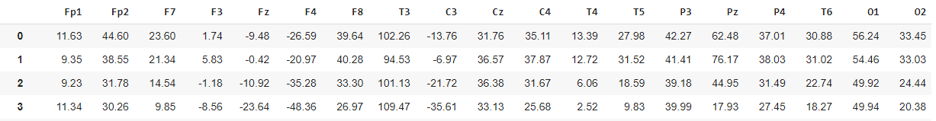
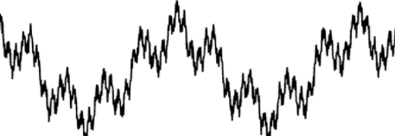
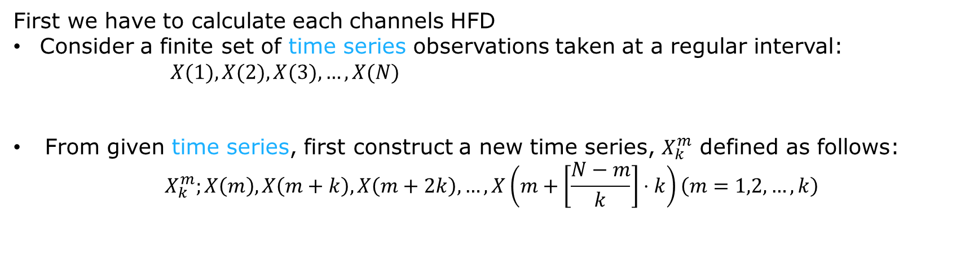
How to calculate Higuchi’s Fractal Dimension (HFD)
First we have to calculate each channels HFD
Consider a finite set of time series observations taken at a regular interval:
$X(1),X(2),X(3),…,X(N)$
From given time series, first construct a new time series, $X_{k}^{m}$ defined as follows:
$${ X}_{k}^{m};X\left(m\right),X\left(m+k\right),X\left(m+2k\right),…,X\left(m+\left[\frac{N−m}{k}\right]⋅k\right)\left(m=1,2,…,k\right)$$

Slide 2

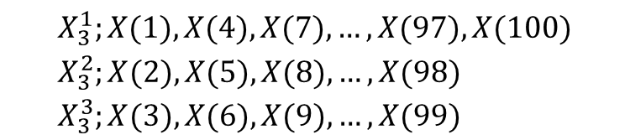
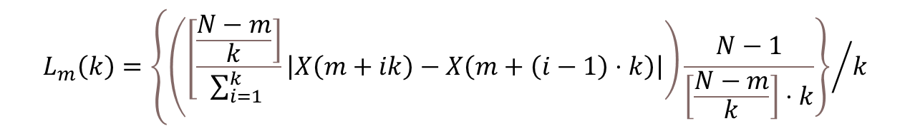
How to calculate HFD
In the case of k = 3 and N = 100, three time series obtained by the above process are described as follows:
$$\begin{aligned}&X_{3}^{1};X(1),X(4),X(7),…,X(97),X(100) \\ &X_{3}^{2};X(2),X(5),X(8),…,X(98) \\ &X_{3}^{3};X(3),X(6),X(9),…,X(99)\end{aligned}$$
Length of the curve, $X_{k}^{m}$ , as follows:
$$L_{m}\left(k\right)=\left\{{\left(\left[\frac{\left.\frac{N−m}{k}\right]}{\sum_{i=1}^{k}{ }}\left|X\left(m+ik\right)−X\left(m+\left(i−1\right)⋅k\right)\right|\right)\frac{N−1}{\left[\frac{N−m}{k}\right]⋅k}\right\}}/k\right.$$

Slide 3
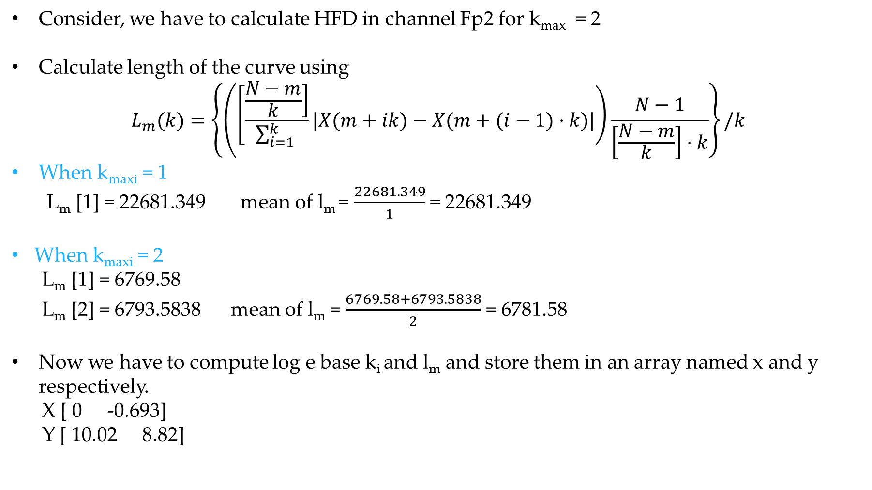
How to calculate HFD
Consider, we have to calculate HFD in channel Fp2 for k_{max} = 2
Calculate length of the curve using
$$L_{m}(k)=\left\{\left(\left[\frac{\left.\frac{N−m}{k}\right]}{\sum_{i=1}^{k}{ }}|X(m+ik)−X(m+(i−1)⋅k)|\right)\frac{N−1}{\left[\frac{N−m}{k}\right]⋅k}\right\}/k\right.$$
When k_{maxi} = 1
L_{m} [1] = 22681.349 mean of l_{m} = $\frac{22681.349}{1}$ = 22681.349
When k_{maxi} = 2
L_{m} [1] = 6769.58
L_{m} [2] = 6793.5838 mean of l_{m} = $\frac{6769.58+6793.5838}{2}$ = 6781.58
Now we have to compute log e base k_{i} and l_{m} and store them in an array named x and y respectively.
X [ 0 -0.693]
Y [ 10.02 8.82]

Slide 4

How to calculate HFD
Now calculate summation of x², x, xy and y²
Sx² = 0.48
Sx = -0.693
Sxy = -6.115
Sy = 18.85
Compute denominator and numerator of linear regression using
den = k_{max} * sx² - (sx)²
num = k_{max} * sxy - sx * sy
den = 0.48
num = 0.836
slope = $\frac{num}{den}$ = $\frac{0.836}{0.48}$ = 1.741
HFD value: 1.741 MRMR
Average HFD = $\frac{Every channel^{′}s hfd}{number of channel}$

Slide 5

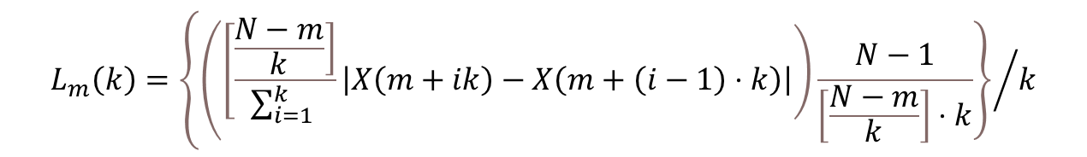
How to calculate HFD
Higuchi’s Fractal Dimension
$$L_{m}\left(k\right)=\left\{{\left(\left[\frac{\left.\frac{N−m}{k}\right]}{\sum_{i=1}^{k}{ }}\left|X\left(m+ik\right)−X\left(m+\left(i−1\right)⋅k\right)\right|\right)\frac{N−1}{\left[\frac{N−m}{k}\right]⋅k}\right\}}/k\right.$$
log($L_{m}\left(k\right)$)
log(1. / k)
Slop of this line is the Higuchi’s Fractal Dimension

